Slide 1
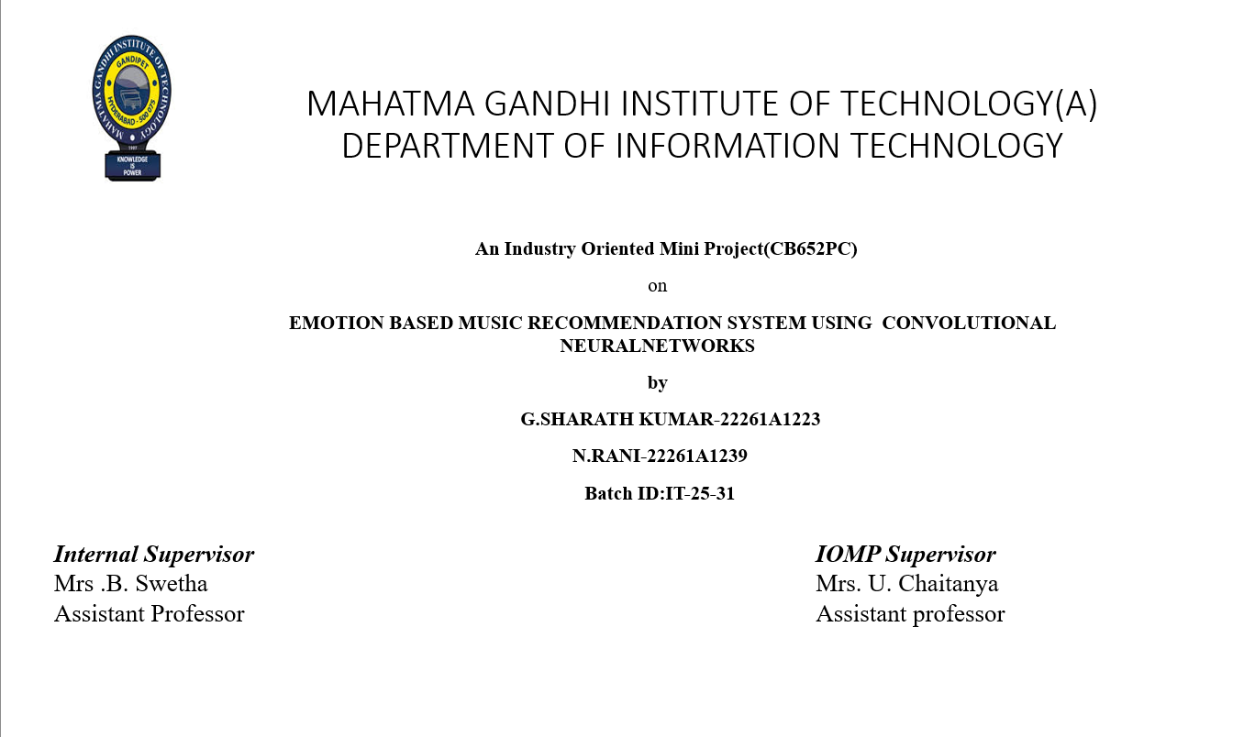

Slide 2
OUTLINE
ABSTRACT
INTRODUCTION
EXISTING SYSTEM
PROPOSED SYSTEM
APPLICATIONS
REQUIREMENTS
LITERATURE SURVERY
PROBLEM STATEMENT
OBJECTIVES
MODULES DESCRIPTION
ALGORITHM
DESIGN ARCHITECTURE&UML DIAGRAMS
RESULTS
FUTURE ENHANCEMENTS
REFERENCES

Slide 3
ABSTRACT
This project aims to develop a real-time, emotion-based music playlist generator that dynamically curates song recommendations based on the user’s emotional state. The system integrates advanced machine learning techniques for emotion detection through three input modes: text-based sentiment analysis, voice emotion recognition, and facial expression analysis. The backend leverages deep learning models (CNN/LSTM) for voice analysis, facial emotion recognition using OpenCV and DeepFace, and NLP-based sentiment detection to accurately classify user emotions.
Once the emotion is identified, a hybrid recommendation system combines collaborative filtering and content-based filtering to suggest songs that match the detected mood. The system seamlessly integrates with Spotify, Apple Music, and Last.fm APIs to fetch personalized playlists. Over time, it learns user preferences for enhanced recommendations. The front-end provides an intuitive interface, allowing users to manually adjust playlists if desired.
With support for real-time emotion detection, dynamic playlist generation, and cross-platform deployment on Heroku or AWS, this application offers an innovative and personalized way to engage with music, transforming the listening experience through AI-driven emotional intelligence.

Slide 4
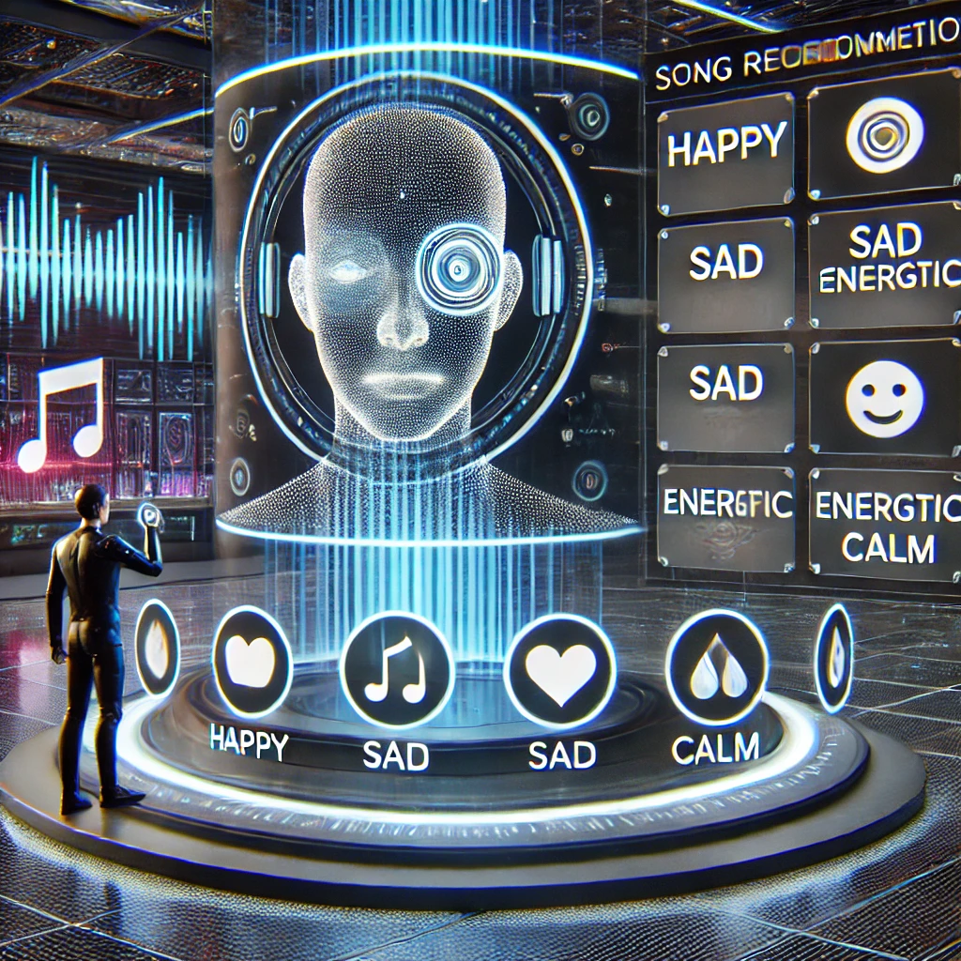
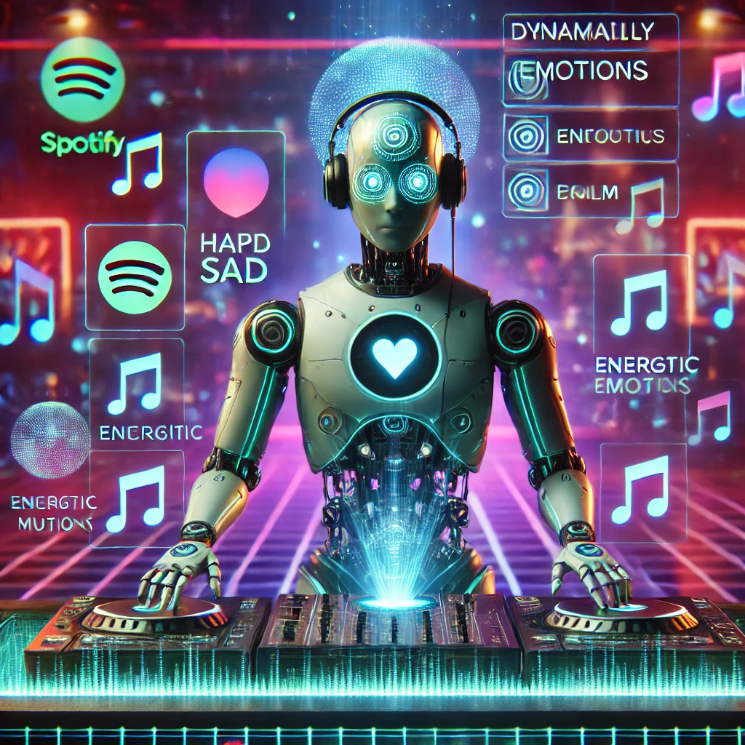
INTRODUCTION
Traditional music recommendation systems primarily rely on user history, genres, or popularity trends, often failing to capture the real-time emotional state of the listener.
This project introduces an emotion-based music playlist generator, leveraging advanced machine learning techniques to curate dynamic song recommendations based on the user’s current emotions.
A hybrid recommendation system combining collaborative filtering and content-based filtering enhances personalization, while APIs from Spotify, Apple Music, and Last.fm provide seamless access to a vast music library.
With real-time emotion detection and AI-driven intelligence, this application offers a more immersive and emotionally connected listening experience.

Slide 5
EXISTING SYSTEM
1. Text-Based Systems (Keyword Matching, Rule-Based NLP)
.Uses the keyboard to take input
.Tech: rule based nlp.
.Limitations:
Context Ignorance: Can't distinguish context (e.g., "I’m not happy" might still be tagged as happy due to the word "happy").
Language Dependency: Performance drops significantly if user inputs are in languages not supported by the rule base.
2. Tag-Based Music Recommendation (Based on Metadata/Genre/Artist Tags)
.Uses specific tags to recommend music
Tech:based on genre classification
Limitations:
Emotion-Music Mismatch: Tags like "pop", "rock", or "romantic" don’t always represent the emotional tone of a song.
Cold Start Problem: Struggles with new users or songs with missing/incomplete tags.

Slide 6
PROPOSED SYSTEM
The proposed system is an Emotion-Based Music Recommendation System that uses Convolutional Neural Networks (CNN) to detect a user's emotion in real-time from their facial expressions. Based on the identified emotion—such as happy, sad, angry, or neutral—the system recommends suitable songs by mapping emotions to specific music moods. The music is fetched from platforms like Spotify or from a pre-labeled dataset. This approach provides a more personalized and dynamic music experience compared to traditional text-based or tag-based systems. The system includes a user-friendly interface, real-time emotion detection, and automatic music playback based on the user's current mood.
Benefits Over Traditional Systems:
Dynamic & Real-Time: Detects mood instantly via facial cues.
Deep Learning Accuracy: CNN provides better emotion recognition than rule-based or keyword methods.
Personalized Experience: Aligns music with how the user feels in the moment.

Slide 7
APPLICATIONS
Personalized Music Streaming Platforms
Mental Health & Therapy Support
Smart Devices & IoT Integration
Gaming & Virtual Reality
Entertainment Systems
Customer Experience Enhancement
Education & E-Learning

Slide 8
HARDWARE AND SOFTWARE SPECIFICATIONS
Software Specifications
Frontend frameworks such as react.js and tools such as html,css
Databases such as MongoDB
API’s like Spotify API and Apple Music API
Libraries such as Tensorflow, Surprise library
Hardware Specifications:-
Intel i5 Processor
A laptop with web cam
RAM of size 16 GB and Storage of 512 GB.

Slide 9
LITERATURE SURVEY
S.No | Author Names,Year | Joural/Conference Name & Publisher | Methodology/Algorithms Used | Merits | Demerits | Research Gaps
1 | Swetha Kambham et al. (2025) | ArXiv (Preprint) | Facial expression analysis using DeepFace; music recommendation based on detected emotions | Real-time emotion detection; personalized playlists | Only uses facial input; local playlist data | Lacks multi-modal emotion analysis and streaming integration
2 | Rajesh B et al. (2024) | ArXiv (Preprint) | Emotion detection with ResNet50 on FER dataset; GRAD-CAM for explainability | 82% accuracy; explainable model | Focused on facial analysis only | Requires multimodal recognition (text, voice)
3 | Aswin Jeba Mahir A et al. (2024 | Int’l Research Journal on Advanced Engineering and Management | CNN for facial emotion in real-time; mood-based music recommendation | Real-time, engaging UX | Facial-only input may miss emotional subtleties | Combine multiple emotional indicators (facial, voice, text)
4 | Kurniawan et al. (2023) | JOIV: International Journal on Informatics Visualization | Face detection via Haar-cascade; emotion classification using CNN; music suggestions by emotion | 84.44% accuracy; dynamic music recs | Only facial expressions; limited emotion scope | Needs voice and text integration for better emotion coverage
5 | S Metilda Florence, M Uma (2020) | IOP Conf. Series: Materials Science and Engineering | Facial emotion recognition + music mapping | Simple, user-friendly mood-based recs | Doesn’t use vocal/text cues | Expand to hybrid detection models

Slide 10
PROBLEM STATEMENT
In today’s digital age, users are overwhelmed with a vast amount of music choices, yet existing music recommendation systems often fail to align with a user’s real-time emotional state. Traditional methods rely heavily on static data like user history, keywords, or manual playlists, which lack the ability to adapt to a user’s current mood. This gap results in a less engaging and impersonal music experience. There is a need for an intelligent system that can accurately detect a user’s emotion in real-time and recommend music that resonates with their current feelings. This project aims to develop an emotion-based music recommendation system using Convolutional Neural Networks (CNN) to analyze facial expressions and provide dynamic, mood-aligned music suggestions.

Slide 11
OBJECTIVES
To develop a system that detects human emotions using CNN from facial expressions.
To develop a system that detects human emotions using CNN from facial expressions.
To classify emotions into categories such as Happy, Sad, Angry, Neutral, etc.
To map each detected emotion to a suitable music mood or genre.
To enhance personalization and user satisfaction through emotion-aware music suggestions.

Slide 12
MODULES
1. Emotion Detection Module
Purpose: Captures and analyzes facial expressions to identify the user's current emotion.
Technology Used: OpenCV for image capture, CNN model trained on datasets like FER-2013 or CK+.
Output: Emotion label (e.g., Happy, Sad, Angry, Neutral).
2. Emotion Classification Module
Purpose: Processes the CNN model output to classify emotion into a defined category.
Functionality: Maps facial features to emotion classes using a trained CNN.
Output: Clean, labeled emotion ready for mapping.

Slide 13
3.Emotion-to-Music Mapping Module
Purpose: Connects each emotion to a suitable type or mood of music.
Example:
Happy → Pop, Dance
Sad → Soft, Acoustic
Angry → Rock, Lo-Fi
Logic: Can be rule-based or improved using user feedback over time.
4. Music Recommendation Module
Purpose: Recommends songs based on the detected emotion.
Data Sources: Pre-labeled datasets or music APIs like Spotify, YouTube, or Last.fm.
Functionality: Fetches mood-matched songs and displays them to the user.

Slide 14
5. User Interface Module
Purpose: Allows users to interact with the system.
Features:
Capture facial image/video
Display detected emotion
Show and play recommended songs
Collect user feedback (like/dislike)
6.Feedback & Learning Module (Optional/Future Enhancement)
Purpose: Learns from user interactions to improve future recommendations.
Functionality: Adjusts emotion-to-music mapping based on user preferences.

Slide 15
ALGORITHM
1.Initialize the Environment
Import necessary libraries: OpenCV, NumPy, Eel, etc.
Set up the web interface using Eel.
2.Capture User Image
Activate the webcam to capture real-time images of the user.
Display the captured image on the web interface for user confirmation.
3.Preprocess the Image
Convert the captured image to grayscale.
Resize the image to match the input dimensions required by the emotion detection model (e.g., 48x48 pixels).
4.Load Pre-trained Emotion Detection Model
Load the pre-trained Convolutional Neural Network (CNN) model designed to classify facial expressions into emotions such as happy, sad, angry, etc.

Slide 16
Predict Emotion
Input the preprocessed image into the CNN model.
Obtain the predicted emotion label from the model's output.
Map Emotion to Music Genre
Define a mapping between detected emotions and music genres or playlists.
For example:
Happy → Upbeat Pop Playlist
Sad → Soft Acoustic Playlist
Angry → Rock Playlist
Neutral → Chill Instrumental Playlist
Select and Play Music
Based on the predicted emotion, select a corresponding playlist or song.
Play the selected music track through the web interface.
Monitor and Update
Continuously monitor the user's facial expressions at intervals.
If a change in emotion is detected, update the music selection accordingly.

Slide 17
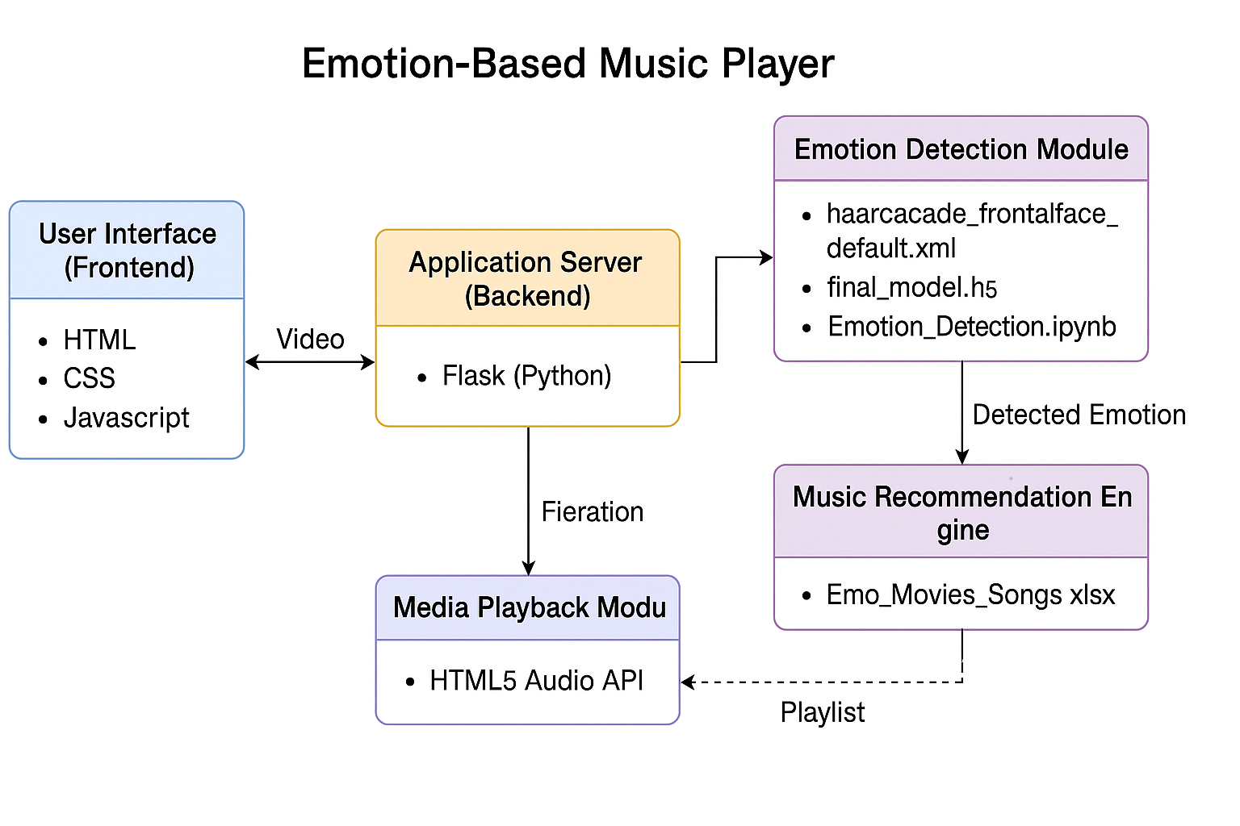
DESIGN ARCHITECTURE

Slide 18
UML DIAGRAMS

Slide 19
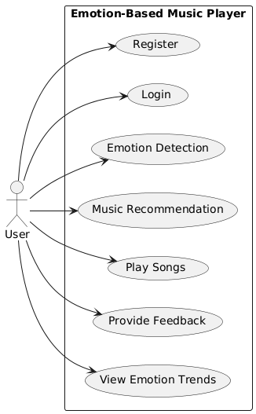
USE CASE DIAGRAM

Slide 20
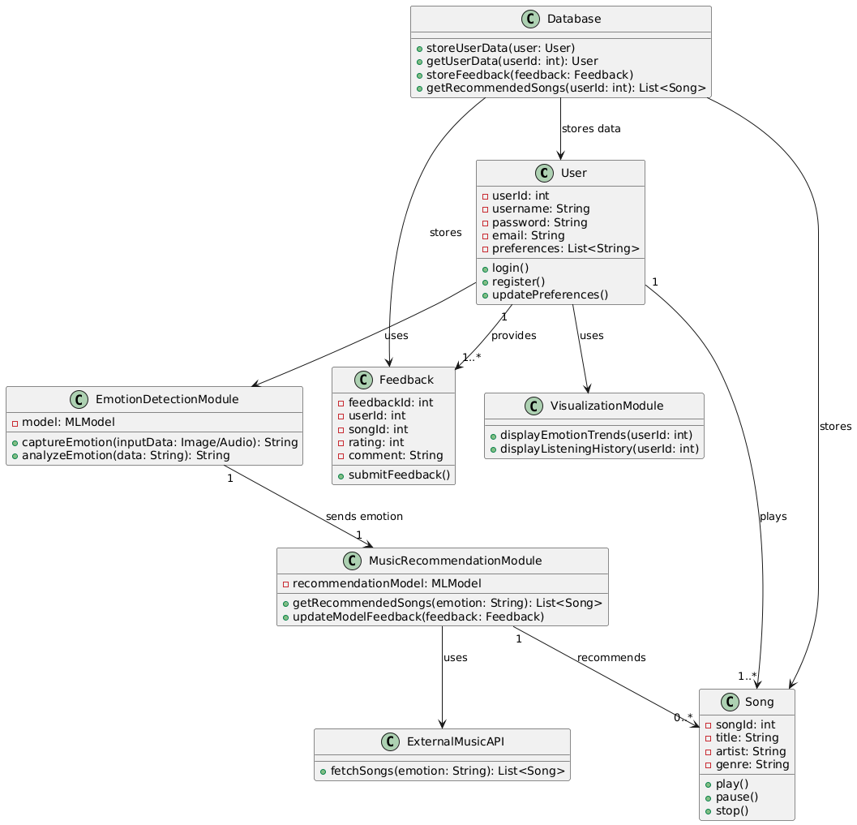
CLASS DIAGRAM

Slide 21
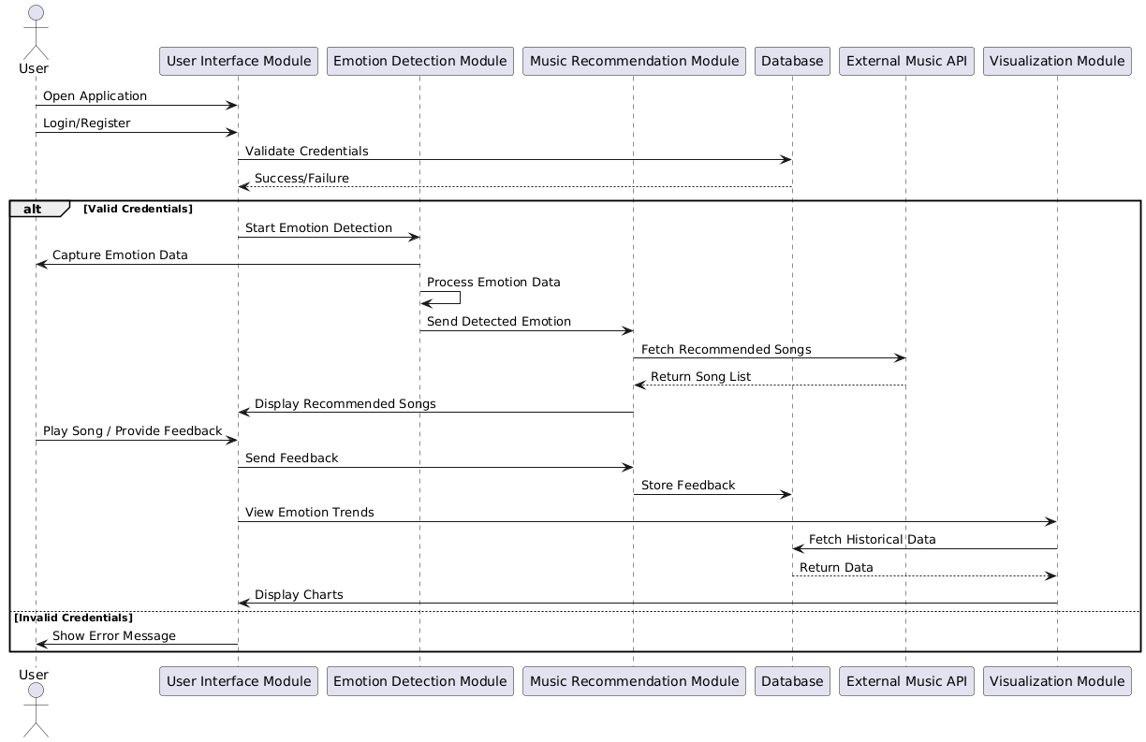
SEQUENCE DIAGRAM

Slide 22
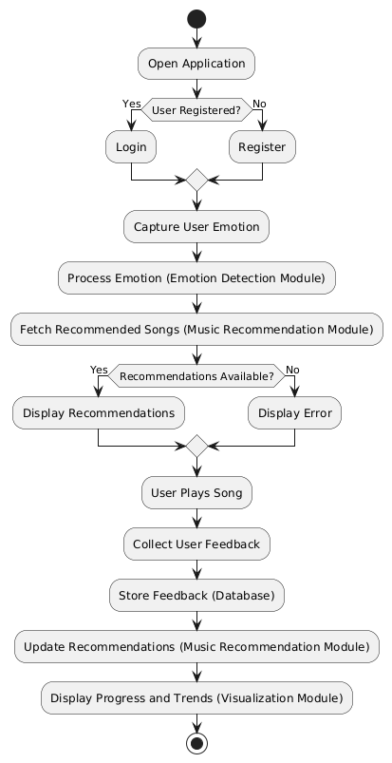
ACTIVITY DIAGRAM

Slide 23
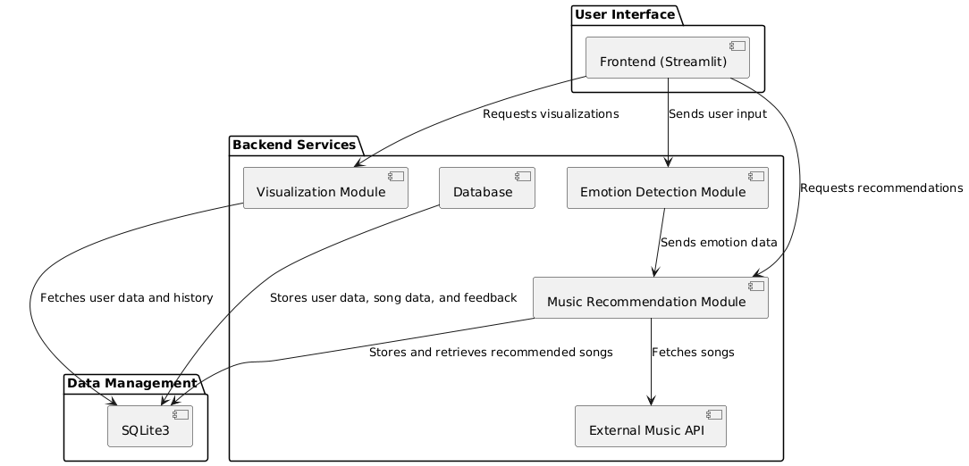
COMPONENT DIAGRAM

Slide 24
TEST CASES

Slide 25
S.NO | Test Case Name | Input | Expected Output | Actual Output | Remarks
1 | Webcam Access Granted | User grants webcam permission | Video stream starts | Video stream starts | Pass
2 | Webcam Access Denied | User denies webcam permission | Show error or prompt again | Error shown | Pass
3 | Detect Happy Emotion | Frame with user smiling | Emotion: Happy | Emotion: Happy | Pass
4 | Detect Emotion - No Face Present | Frame with background only | “No face detected" message shown | "No face detected" shown | Pass
5 | Recommend Music - Unknown Emotion | Frame with unreadable expression | Default or empty playlist shown | Default playlist shown | Pass
6 | Play Song | User clicks Play button | Music starts playing | Music plays | Pass
7 | Emotion Detection with Multiple Faces | Group photo input | Error or handle only one face | One face detected | Pass
8 | Play Song | User clicks Play button | Music starts playing | Music plays | Pass

Slide 26
RESULTS

Slide 27
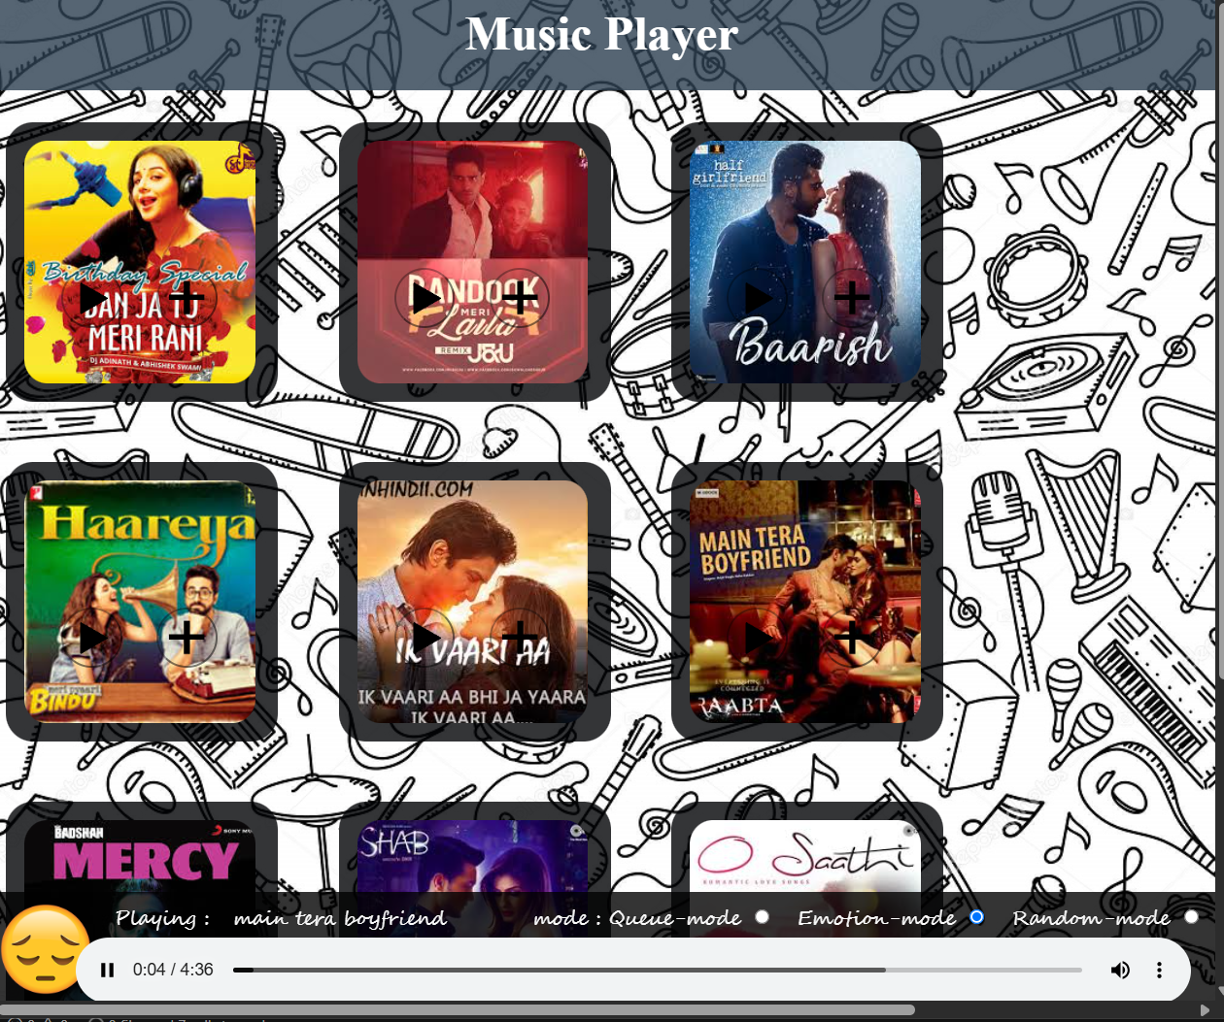
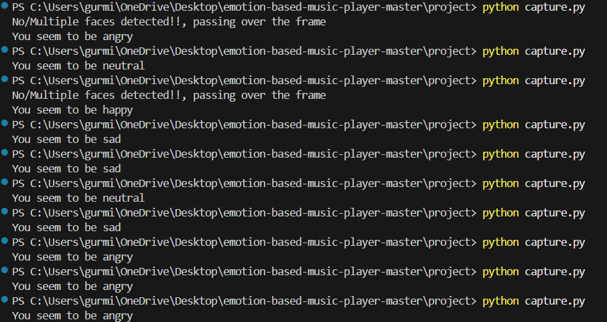

Slide 28
FUTURE ENHANCEMENT
Real-Time Continuous Emotion Tracking
Instead of single emotion detection, track user emotions continuously.
User Authentication and Profiles
Allow users to register/login..
Offline Mode
Cache playlists locally for emotion categories for use without internet.
Voice and Gesture Control
Add support for voice commands (e.g., “Play something happy”).
Mobile App Version
Build cross-platform apps using Flutter or React Native.

Slide 29
CONCLUSION
The Emotion-Based Music Player successfully bridges the gap between technology and human emotion by using facial expression analysis to curate personalized music playlists. This project demonstrates the potential of combining computer vision and music streaming to enhance user experiences. By leveraging facial recognition technology, it intelligently adapts to the user's emotional state, offering a dynamic and engaging way to discover music. With further development and integration, this system can evolve into a comprehensive platform for emotional well-being and entertainment, offering users a unique, interactive, and personalized music journey.

Slide 30
REFERENCES
[1] Jaladhi Sam Joel, B. Ernest Thompson, Steve Renny Thomas, T. Revanth Kumar, Shajin Prince, D. Bini, “Emotion-Based Music Recommendation System using Deep Learning Model,” IEEE Access, 2023. https://ieeexplore.ieee.org/document/10134389
[2] Brijesh Bakariya, Arshdeep Singh, Harmanpreet Singh, Pankaj Raju, Rohit Rajpoot, Krishna Kumar Mohbey, “Emotion-Based Music Recommendation System,” Volume 15, pp. 641–658, 2024. https://link.springer.com/article/10.1007/s12530-023-09506-z
[3] Harshanil, Mandar Karmakar, Rashmi Astogi, “Music Mood Prediction and Playlist Recommendation based on Facial Expressions,” Article No. 92, pp. 1–6. https://doi.org/10.1145/3647444.3647919
[4] Tina Babu, Rekha R. Nair, Geetha A., “Emotion-Aware Music Recommendation System: Enhancing User Experience Through Real-Time Emotional Context.” https://doi.org/10.48550/arXiv.2311.10796

Slide 31

CODE EXECUTION VIDEO

Slide 32
THANK YOU !!

